Slide 1
Comberton Eco Award For year 7 and year 8

Slide 2
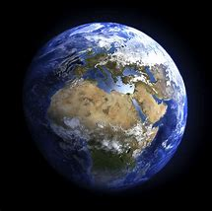
Comberton Eco Award
3 Sections to complete
Head: To complete a project with a ‘solutionary’ view on a topic
Heart: To have taken part in a Nature based activity outdoors
Hands: To have taken an eco action

Slide 3
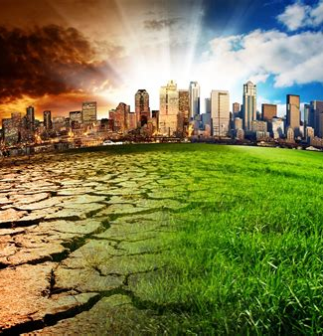
Head
To take a topic: such as Transport, and to look at the issues behind it and how it can be made more sustainable in the future and present it in some form: this could be a PowerPoint, a display, a written report, a film or in any other format.
This could involve skills such as: Systems Thinking - seeing what other things are connected to this problem / solution; Futures Thinking – looking at possible futures based on the decision we make and choosing a path that leads us where we would like to go; Critical Thinking – questioning current norms and the assumptions behind them and looking critically at the reliability of different sources of information.

Slide 4
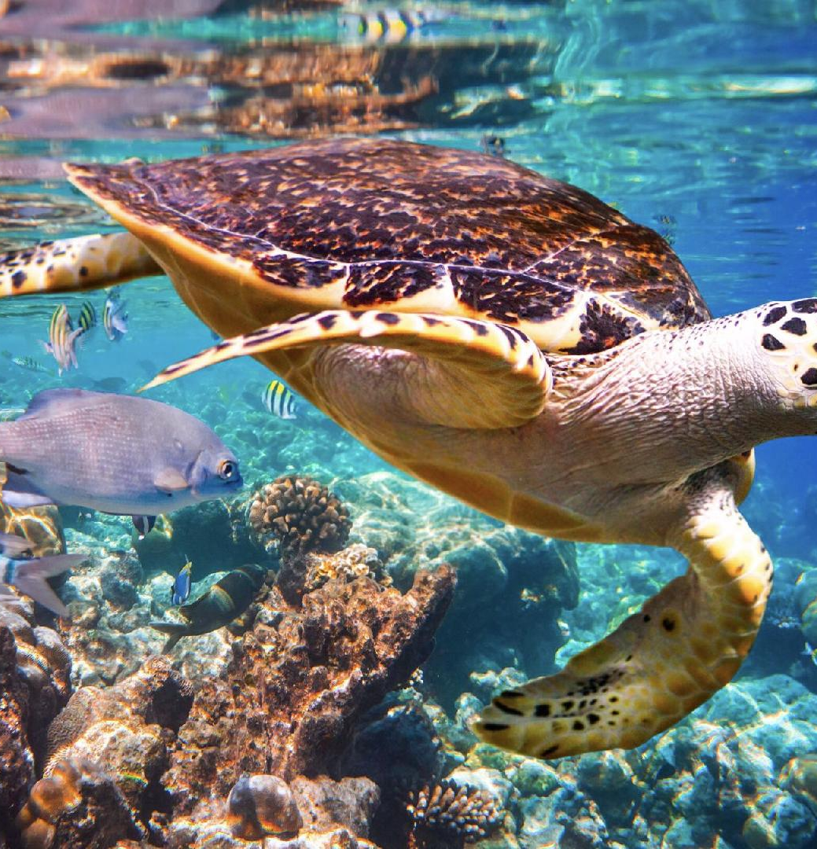
Heart
To gain an appreciation of Nature. This could include any of the suggestions below
To plant and grow something at home or at school.
To take part in a Nature based activity – such as the RSPB garden bird watch or take photos of wild flowers or mushrooms in the local area
To do something practical to increase biodiversity at home or a school

Slide 5
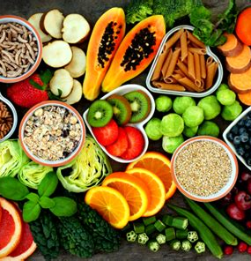
Hands
To take action. This could include any of the suggestions below:
To reduce your carbon footprint by changing what you eat
By buying less fast fashion and upcycling old clothes
Learning how to repair broken items
By taking public transport rather than going by car
By organising your recycling at how so that less goes in the general waste.
.

